Slide 1
Welcome to the Launch of
GGS-II Wave 1 in the UK!
Brienna Perelli-Harris
Olga Maslovskaya
Ann Berrington
Grace Chang
Bernice Kuang
19 January 2024
@CPCpopulation

Slide 2
Today’s Event
-Generations and Gender Programme Overview
Anne Gauthier, Director
-UK GGS
Lunch
-Methodological Presentations
-Substantive Presentations

Slide 3
The Generations and Gender Survey in the UK
First time UK GGS is funded
Directly comparable to international GGS
All adults aged 18-59
Focus on family formation years
Captures underrepresented cohort (millennials)
Worked closely with NatCen, UK survey research agency
Work packages in ESRC grant
Methodological development: data quality, representativeness, incentive experiment, QR-code experiment
Olga Maslovskaya, CoI; Grace Chang, Post-doc
2) Analysis of partnership and fertility histories, childcare
Ann Berrington, CoI; Bernice Kuang, Post-doc

Slide 4
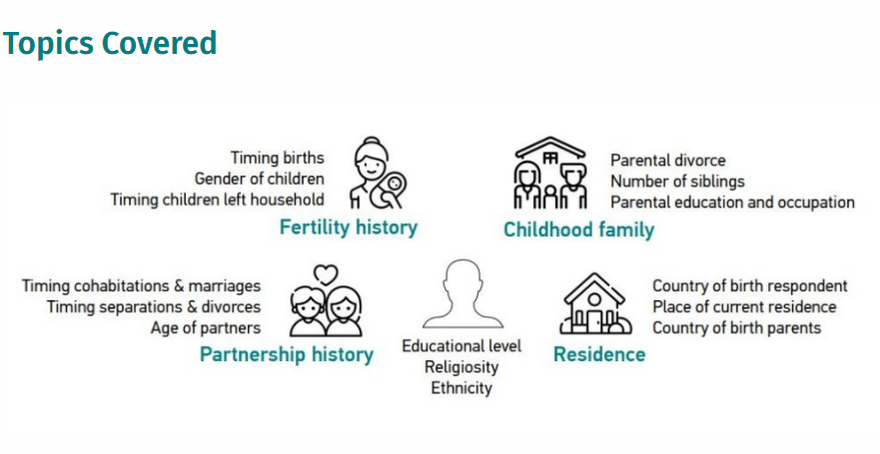

Slide 5
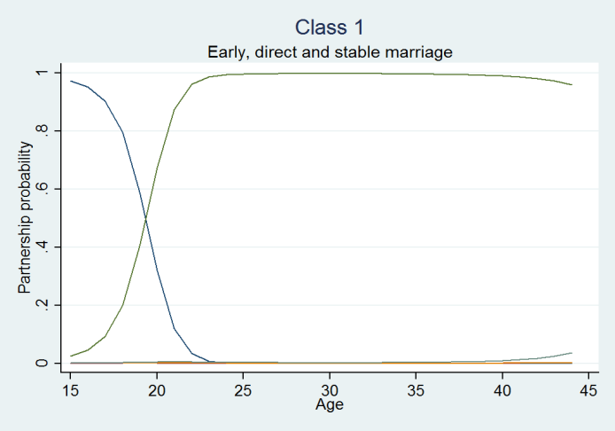
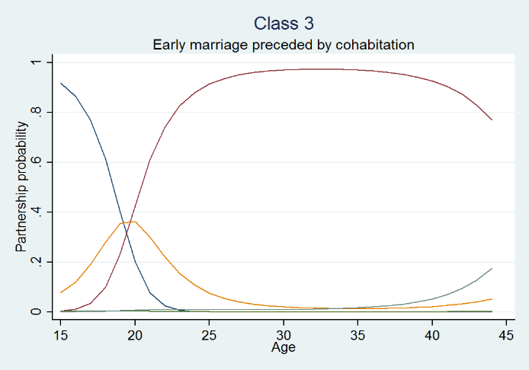
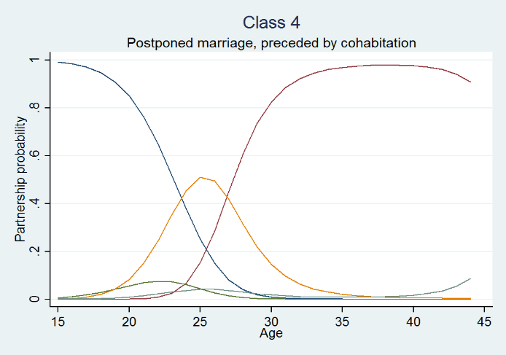
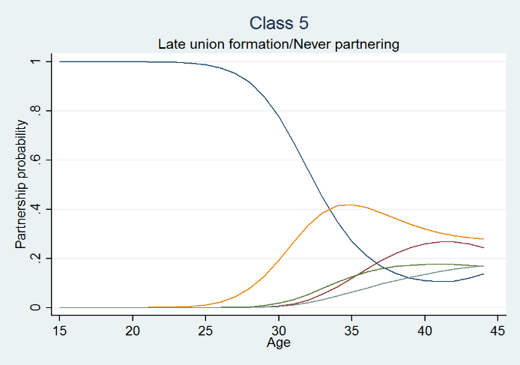
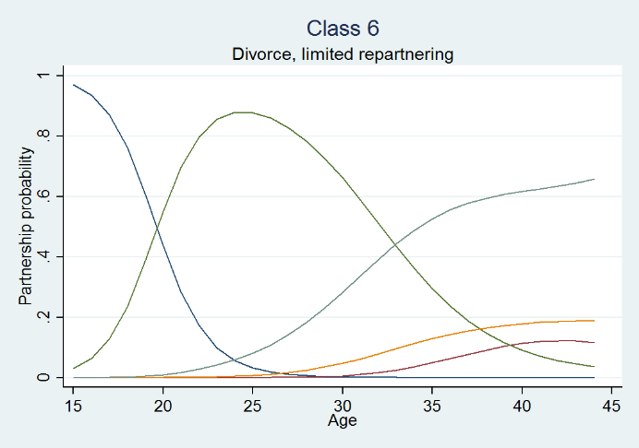
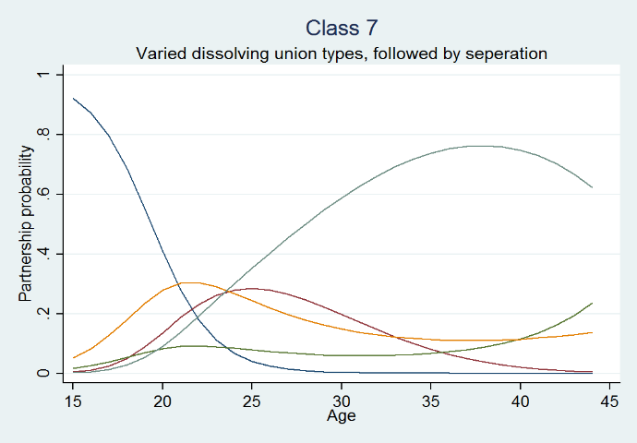
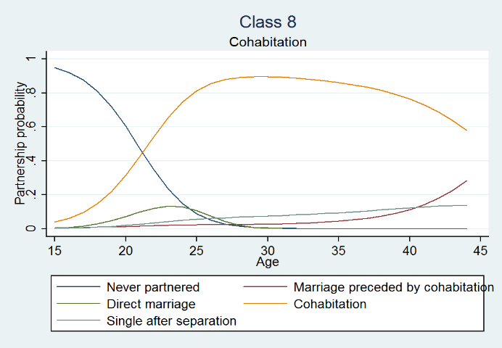
Latent class growth models describing relationship patterns
Perelli-Harris, B., & Lyons-Amos, M. (2016). Partnership patterns in the United States and across Europe: The role of education and country context. Social Forces, 95(1), 251-282.

Slide 6
Additional topics covered by the GGS
Employment, including irregular work schedules, parental leave, remote working
Partner’s education and employment
Attitudes to work-family balance, parenting, gender division of labour
Parents and intergenerational relations

Slide 7
The GGS in the UK
Took place post-Covid, during the Cost of Living Crisis
Additional questions on:
Ethnicity
Brexit
Reasons for leaving parental home
Concerns about the future (terrorism, climate change, economic uncertainty, refugees)
Risk-taking and trust

Slide 8
The UK GGS Timeline
Jan 2022
June
–
Jul
Aug
Aug
Nov
Jan
2023
Phase 1
Questionnaire and software development
Phase 2
Data collection
Cognitive user testing interviews
Stage 1
Collected first half of the data
(N~3500)
Incentive
Experiment
Decision about incentives for Stage II
Stage 2
Collected second half of the data
(N~3500)
QR code v.s. link
Weighting
& final data cleaning

Slide 9
Phase 1
Infrastructure enhancement grant to:
Improve look and feel, especially on mobile devices
Improve collection of dates and partnership histories
Introduce new, UK questions
Used Cognitive Interviewing to test design enhancements

Slide 10
Cognitive User Testing
 | Relationship history | Children | Children with multiple partners | Living with parents | Digital confidence
 | Cohabited with 2+ partners in lifetime | 3+ children | Children with multiple partners | Still living in parental home | Less confident
Quota set | Min 3 | Min 3 | Min 3 | Min 3 | Min 3
Total screened by Propeller | 7 | 4 | 4 | 3 | 6
Total when screened by interviewers | 8 | 4 | 4 | 3 | 4
12 interviews
Participants were trained to ‘think aloud’ to talk through their thought process with the interviewer, followed by probing questions after completion of the survey
 | Gender |  | Age |  |  | Device type
 | Men | Women | 18-30 | 31-45 | 46-59 | Smart phone/ tablet | Laptop/ PC
Quota set | Min 6 | Min 6 | Min 3 | Min 3 | Min 3 | Min 8 | Min 4
Total when screened by Propeller | 6 | 6 | 3 | 3 | 6 | 8 | 4
Total when screened by interviewers | 6 | 6 | 3 | 3 | 6 | 4 | 8

Slide 11
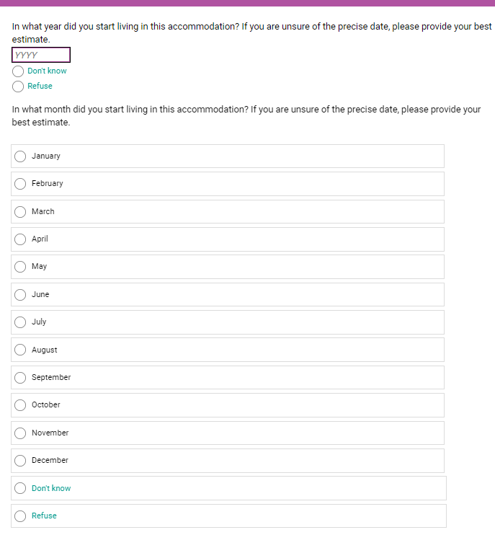
Cognitive User Testing:
Date entry formats
GGP format: [MM/YYYY]
We suspected that date entry was cumbersome and not optimized for smartphones.
We also wanted to allow respondents to enter don’t know for either year or month (not both).
Tested the following formats:
[MM/YYYY]. Two types of questions; one without a soft prompt and one with a soft prompt (as seen in previous slide)
First to enter year [YYYY], followed by month [MM]
Best format is a written year [YYYY], followed by choosing pre-defined months

Slide 12
Cognitive User Testing: Summary tables of partnership and fertility histories
Known drop-off during life events section of GGS
Sought alternative ways of collecting retrospective data
Event history calendars found to prompt memory of events, although only tested in face-to-face surveys
Conducted a workshop on online collection of different life histories
Concern about feasibility on smartphones
Developed summary table to be included after fertility and partnership section to aid recall

Slide 13
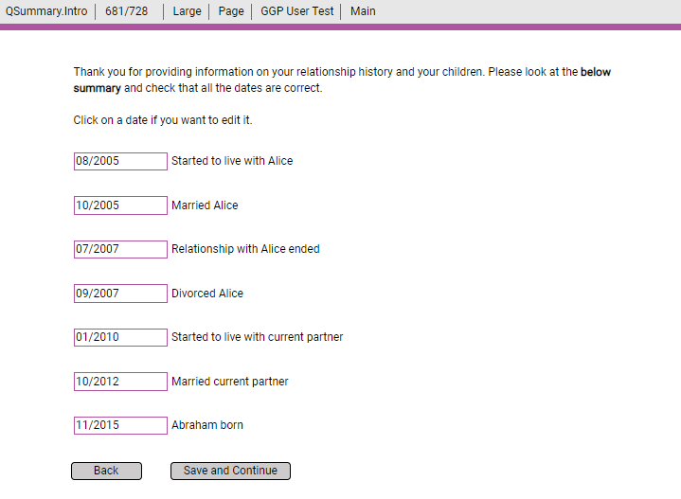
Cognitive User Testing: Summary tables of partnership and fertility dates

Slide 14
Cognitive User Testing: Summary tables of partnership and fertility dates
Cognitive Testing participants did not think that tables improved recall dates or willingness to amend dates
Instead, tables raised privacy concerns, esp. after seeing the summary table
Participants said they did not like seeing all of their past laid out before them
“is Big Brother watching you?” (Female, age group 46-59 years, 2 partners, 2 children)
Participants also did not like providing information for ex-partners
One participant would have deleted all their information if they were not with an interviewer; other participants broke off after seeing table.
Notes:
More work needs to be done to understand privacy concerns of participants in summary tables

Slide 15
Phase 2: Data collection
Online data collection – no interviewer present to guide respondents through the questionnaire
No individual-level sampling frame in the UK
Postcode Address File PAF (address-based sampling frame) – has deadwood and does not have names, telephone numbers or email addresses of people – cannot specify 18-59 year olds
Within household selection of individuals – can introduce self-selection bias in survey estimates
One individual per household and last birthday method

Slide 16
Data collection
84,650 issued sample size (~ half in each stage)
Deadwood/ineligibility rate: 38.4%
N=7,204 (>target 7k)
Response rate=15.1%
First set of invitation letters sent on a Wednesday (white envelope)
Reminder sent 10 days after Mailing 1 (on a Friday) (manilla envelope)
2nd reminder sent 12 days after Mailing 2 on a Wednesday (white envelope)
Mailing 1
Mailing 2
Mailing 3
Notes:
We used the most up to date evidence to maximise response and participation
Recommended use of regional sampling starta, proportionate to the share of total households with 1 or more individual aged 18-59
Estimated RR was 13.8%
Contact strategy: 1 invitation letter and 2 reminder letters

Slide 17
Data Deposit
NIDI hub https://www.ggp-i.org/ggs-round-ii/
UK Data Service https://ukdataservice.ac.uk/

Slide 18
Online analysis of the Generations and Gender Surveys

Slide 19
Future of the Generations and Gender Survey
GGS is longitudinal with 3 waves, 3 years apart
UK GGS-II wave 2 to be conducted in 2025-2026
5,898 have agreed to be recontacted for future waves
Now conducting brief survey to update address, email, and phone numbers
Record whether there was a change in partnership or childbearing since previous survey

Slide 20
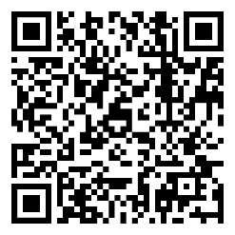
To explore the data & further questions
CPC website https://www.cpc.ac.uk/research_programme/generations_and_gender_survey/#Current
CPC contact
cpc@soton.ac.uk
Notes:
UK GGS a great dataset to use!
If you use it in your research, or for any outputs and would like to share your findings/have any questions, please contact cpc@soton.ac.uk

